Slide 1

E-COMMERCE & RETAIL B2B CASE STUDY
PRESENTED BY : Manali pote

Slide 2
PROBLEM IDENTIFICATION
A sports retail company Schuster dealing in B2B transactions often deals with vendors on a credit basis, who might or might not respect the stipulated deadline for payment.
Vendors delaying their payments result in financial lag and loss which becomes detrimental to smooth business operations.
Additionally, company employees are set up chasing around for collecting payments for a long period of time resulting in no value-added activities and wasteful resource expenditure.

Slide 3
BUSINESS OBJECTIVE
Schuster would like to better understand the customers’ payment behavior based on their past payment patterns (customer segmentation).
Using historical information, it wants to be able to predict the likelihood of delayed payment against open invoices from its customers.
It wants to use this information so that collectors can priorities their work in following up with customers beforehand to get the payments on time.

Slide 4
READING AND UNDERSTANDING DATA
Load the data.
Check the datatype.
Check and handle NA values and missing values.
Dropping unnecessary columns.

Slide 5
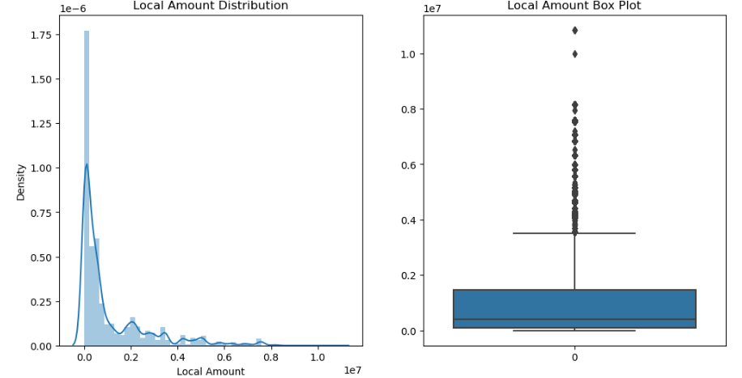
EXPLORATORY DATA ANALYSIS
Univariate Analysis:
Customer Number : No Changes required
RECEIPT_DOC_NO : No Changes required
Local Amount : Dropping the 'Local Amount' column as it does not have a single currency value, and we already have 'USD Amount' column for bill amount.

Slide 6
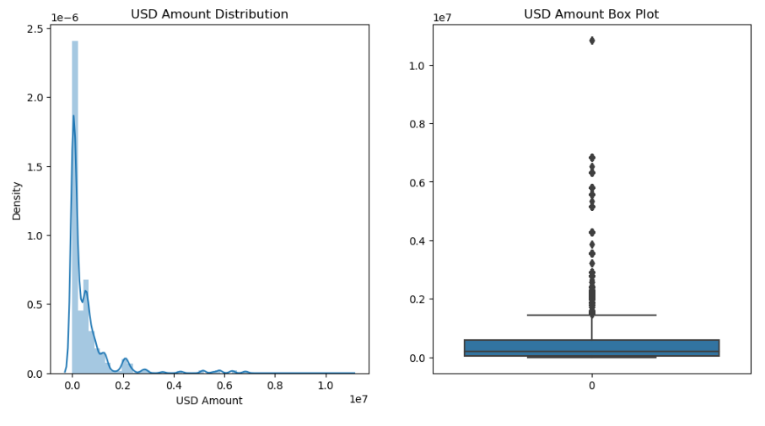
UNIVARIATE ANALYSIS
USD value: Since the USD value is distinct for each transaction and there are no outliers in the data that require adjustment, it can be taken into consideration.

Slide 7
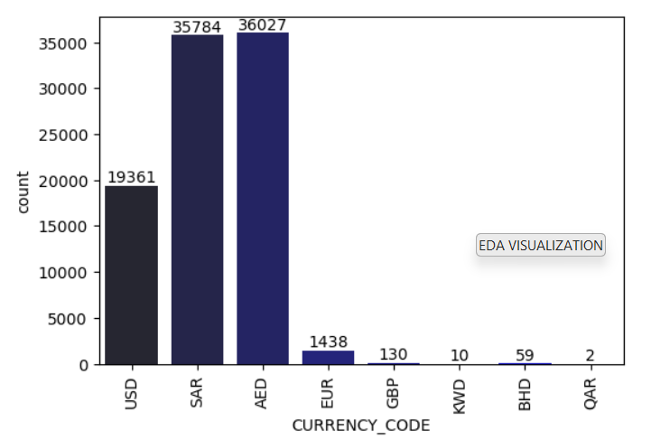
UNIVARIATE ANALYSIS
CURRENCY_CODE : Currency used for bill payments are mostly USD, SAR or AED.

Slide 8
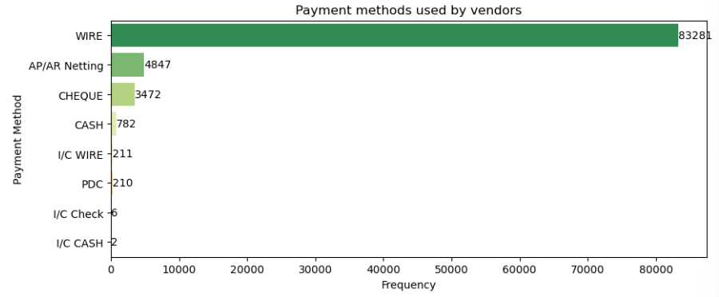
UNIVARIATE ANALYSIS
RECEIPT_METHOD: The most preferred payment method for bill payment is WIRE.

Slide 9
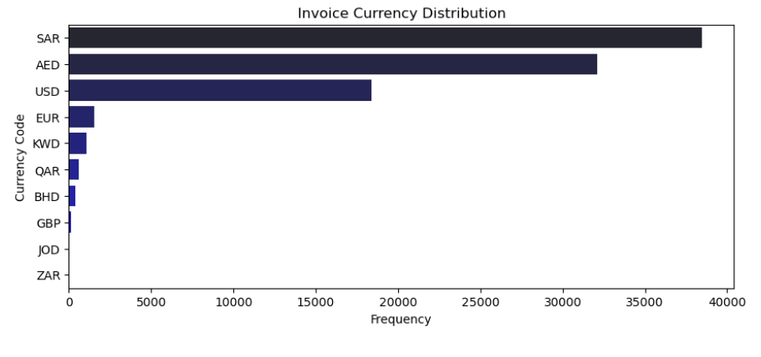
UNIVARIATE ANALYSIS
INVOICE_CURRENCY_CODE : Most number of invoices were generated in SAR, AED and USD currency.

Slide 10
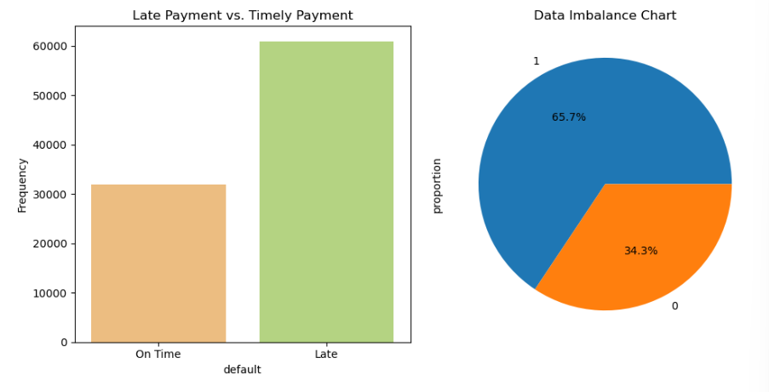
Checking Data Imbalance between on Time Payment & Late Payment
There is a good distribution of data in the target variable.

Slide 11
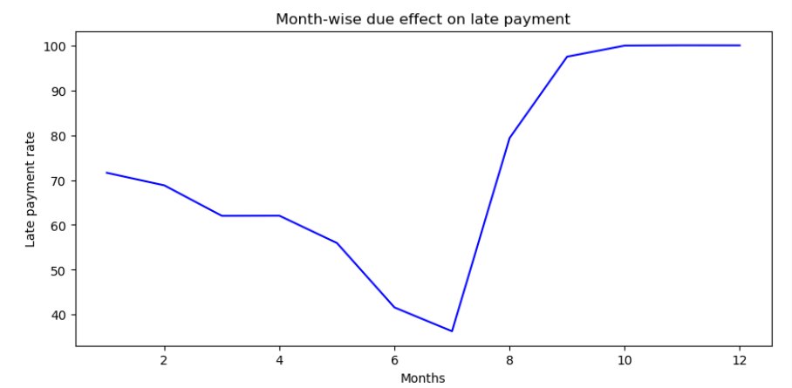
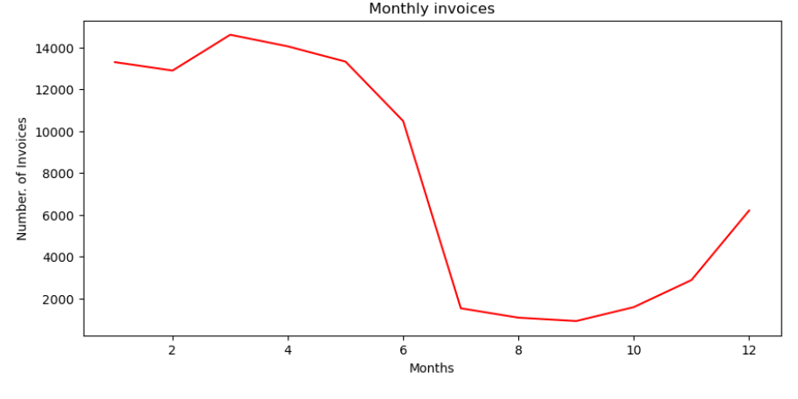
Bi-variate Analysis 1) On the basis of Due month
In the 3rd month, the number of invoices is the highest and the late payment rate is relatively lower compared to other months with a high volume of invoices.
The late payment rate in Month 7 is very low, likely due to the fact that the number of invoices is also low.
The late payment rate rises sharply in the 2nd half of the year starting in the 7th month. In comparison to the first half of the year, there are less invoices.

Slide 12
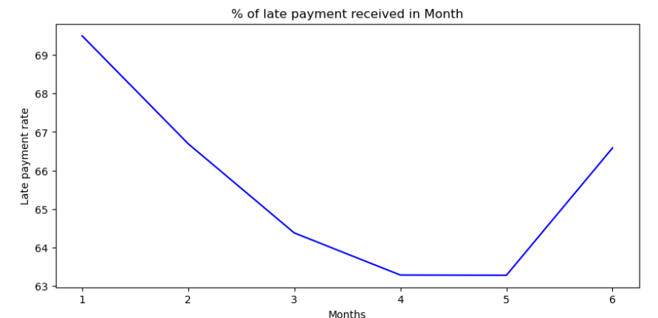
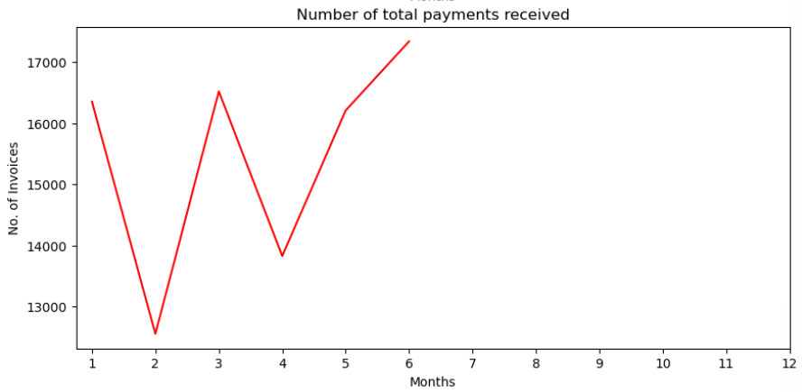
2) On the basis of Receipt_date
No payment received against any invoice from 7th month onwards.

Slide 13
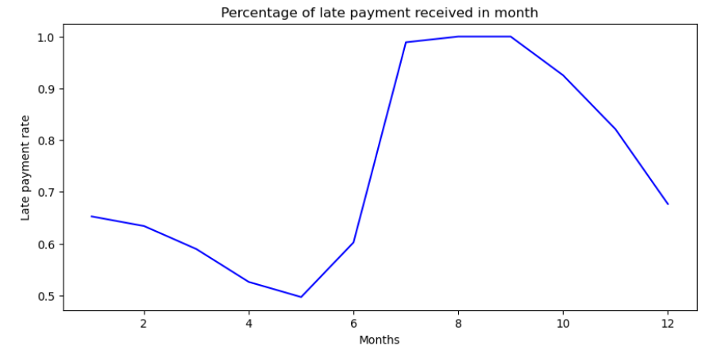
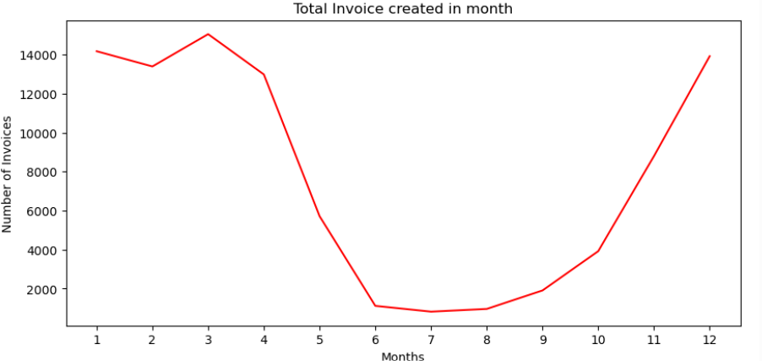
3) On the basis of Invoice Creation month
Late payment rate is decreases from 1st to 5th month.
For the months 7, 8 and 9 the late payment rate is very high.

Slide 14
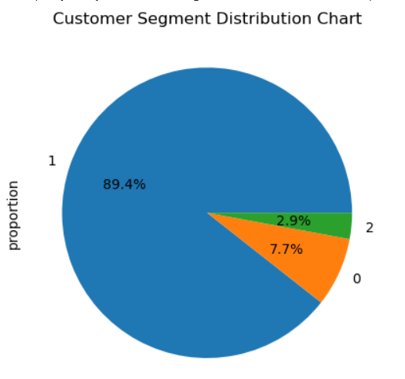
PIE CHART FOR CUSTOMER SEGMENT DISTRIBUTION
Customer Segmentation
'1' Cluster -- Prolonged Invoice Payment
'2' Cluster -- Early Invoice Payment
'0' Cluster -- Medium Invoice Payment
Here we can see that early customers comprise of 89.4% of customers medium and prolonged payers are 10.6% in total.

Slide 15
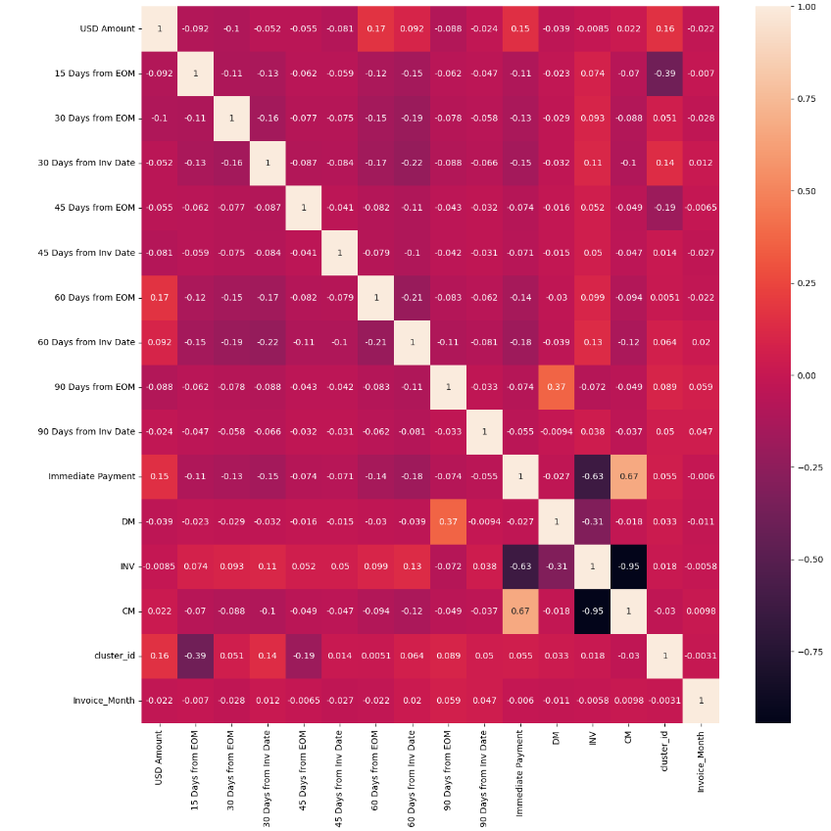
STEPS FOR MODEL BUILDING
1) Data Preparation
2) Train and Test Split - 70:30 split
3) Feature Scaling
4) Plotting Heatmap for Correlation Matrix
CM & INV, INV & Immediate Payment, DM & 90days from EOM has high multicollinearity, hence dropping these columns.

Slide 16
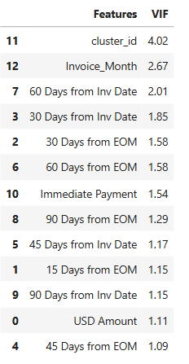
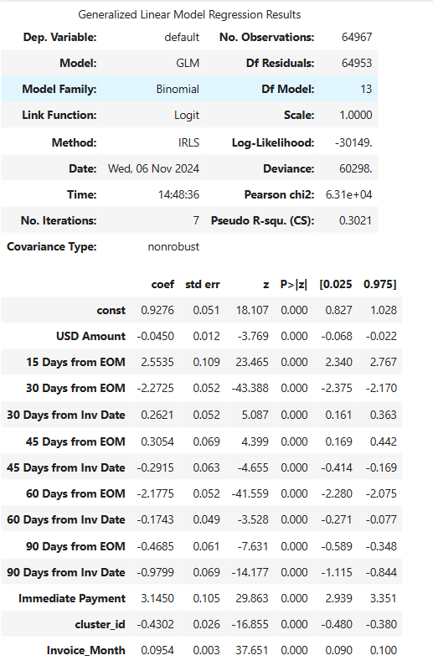
MODEL BUILDING – LOGISTIC REGRESSION
Since the ‘p-value’ and ‘VIF’ fall within an acceptable range, this model can be used.

Slide 17
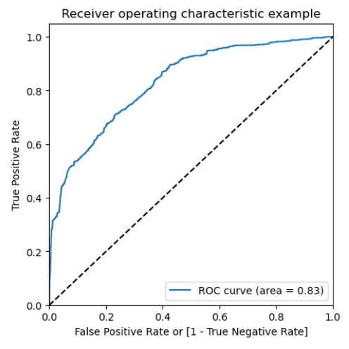
MODEL BUILDING – LOGISTIC REGRESSION
First Model:
Accuracy is 0.7709
Precision is 0.8049
Recall is 0.8585
AUC = 0.83 which shows the model is good.
With this model our train and test accuracy is almost same around 77.1%

Slide 18
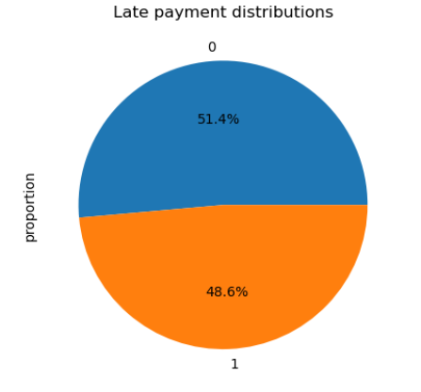
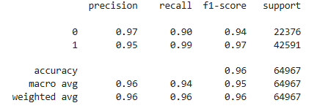
MODEL BUILDING – RANDOM FOREST (CLASSIFICATION MODEL)
Second Model :

Slide 19
RECOMMENDATIONS:
1) Our clustering technique allows us to draw the following conclusions.
2) Compared to debit note or invoice type invoice classes, credit note payments have the highest delay rate; therefore, firm policies regarding payment collection should be more stringent with regard to these invoice classes.
3) Goods type invoices had significantly greater payment delay rates than non-goods types and hence can be subjected to stricter payment policies.
4) It is advised to concentrate more on lesser value payments because they make up the majority of transactions and are also more likely to have late payments. Depending on the billing amount, the business may impose penalties; the lower the bill, the higher the percentage of late payment penalties. This must be the last option, of course.

Slide 20
RECOMMENDATIONS:
5) Three categories—0, 1, and 2—which stand for medium, prolonged, and early payment durations, respectively—were created by clustering customer segments. Cluster 1 consumers should receive special attention because it was discovered that their delay rates were noticeably higher than those of early and middle days of payment.
6) Due to their high likelihood rates, the companies listed above with the highest probability and total and delayed payment counts should be given priority and more attention.

